Slide 1
Machine Learning Project
Isra Mansoor, Muhammad Abdullah

Slide 2
Contents of this presentation
1. Problem statement
2. Data Analysis
3. Supervised Learning
3.1. Data Preprocessing
3.2. Feature Engineering
3.3. Handling Class Imbalance
3.4. Model Implementation
4. Unsupervised Learning
4.1. Without PCA
4.2. With PCA

Slide 3

Problem Statement
Classify rice and cotton crops using NDVI data for improved agricultural management.
Address challenges of data imbalance and ensure model robustness across years.
Evaluate supervised models and clustering methods (with and without PCA).
Use appropriate metrices for evaluation

Slide 4
Data Analysis
Dataset: NDVI time-series for rice and cotton (2021-2023), imbalanced across years.
Data Distribution: Cotton (2021: 2884, 2022: 12412, 2023: 11778); Rice (2021: 420, 2022: 4688, 2023: 920).
NDVI: 12 bi-monthly values per instance, ranging 0-0.85, indicating vegetation health.
Analysis:
Kernel density plots show crop growth stages and spectral patterns.
Histograms reveal skewness across features.
Boxplots identify outliers, varying by year and crop.
Violin plots show varied feature distributions.
Data Quality: No missing values, but duplicates present (e.g., Cotton 2021: 537 duplicates).

Slide 5
Supervised Models
XGBoost (Boosting)
Bagging (Bootstrap Aggregation)
Random Forest
Support Vector Machine (SVM)

Slide 6
Data Preprocessing
Scaling individual datasets using MinMaxScalar.
Duplicates dropping.
Handling outliers using z-score.
Applying data augmentation using sliding window.
Combining yearly datasets.
Feature Engineering by dropping features.
Addressed class imbalance with SMOTE.
Applying scaling on final datasets.

Slide 7
Training and Testing Data
Two datasets created for year 2021 one for training and one for testing
Two datasets created for year 2022 one for training and one for testing
Two datasets created for year 2023 one for training and one for testing
2021
2022
2023

Slide 8
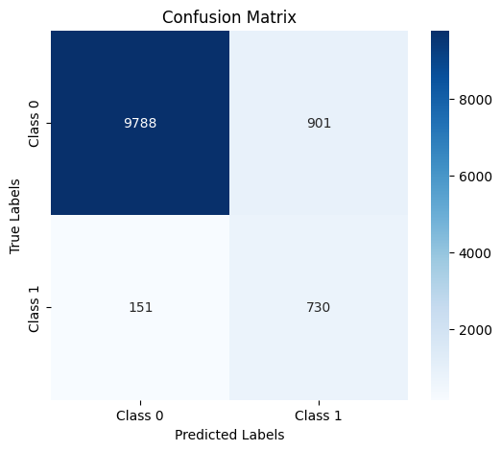

XGBoost (Boosting)
Simple Cross Validation
Fold 1: Training on 2021, 2022 and Testing on 2023
Accuracy: 0.909
ROC: 0.93
Grid Search Cross Validation
Fold 1: Training on 2021, 2022 and Testing on 2023
Accuracy: 0.906
ROC: 0.96
 | Precision | Recall | F1
Cotton | 0.98 | 0.92 | 0.95
Rice | 0.45 | 0.83 | 0.58
 | Precision | Recall | F1
Cotton | 0.98 | 0.91 | 0.95
Rice | 0.44 | 0.83 | 0.57
Feature Importance
NDVI11
NDVI04
NDVI05
NDVI02
NDVI08
Comparing Results
The Grid Search results improved the overall results finding best parameters
learning_rate: 0.4 max_depth: 7 n_estimators: 175

Slide 9
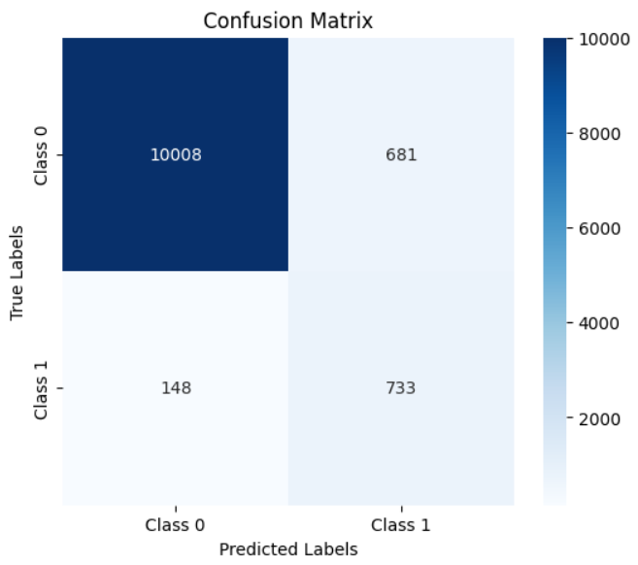
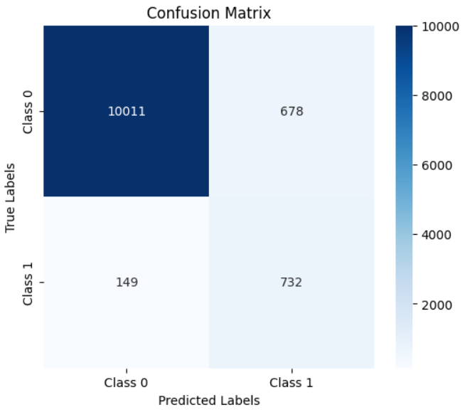
Bagging (Bootstrap Aggregation)
Simple Cross Validation
Fold 1: Training on 2021, 2022 and Testing on 2023
Accuracy: 0.928
ROC: 0.95
Grid Search Cross Validation
Fold 1: Training on 2021, 2022 and Testing on 2023
Accuracy: 0.929
ROC: 0.94
 | Precision | Recall | F1
Cotton | 0.99 | 0.94 | 0.96
Rice | 0.52 | 0.83 | 0.64
 | Precision | Recall | F1
Cotton | 0.99 | 0.94 | 0.96
Rice | 0.52 | 0.83 | 0.64
Feature Importance
NDVI11
NDVI04
NDVI05
NDVI02
NDVI09
Comparing Results
The Grid Search results improved the overall results finding best parameters
estimator: RandomForestClassifier(max_depth=30, n_estimators=10, random_state=42), 'n_estimators': 50

Slide 10


Random Forest
Simple Cross Validation
Fold 1: Training on 2021, 2022 and Testing on 2023
Accuracy: 0.929
ROC: 0.94
Grid Search Cross Validation
Fold 1: Training on 2021, 2022 and Testing on 2023
Accuracy: 0.929
ROC: 0.94
 | Precision | Recall | F1
Cotton | 0.98 | 0.94 | 0.96
Rice | 0.52 | 0.82 | 0.64
 | Precision | Recall | F1
Cotton | 0.98 | 0.94 | 0.96
Rice | 0.52 | 0.82 | 0.64
Feature Importance
NDVI11
NDVI04
NDVI02
NDVI05
NDVI09
Comparing Results
The Grid Search kept the results the same meaning we already had optimal parameters
'max_depth': 30, 'min_samples_leaf': 1, 'n_estimators': 150

Slide 11
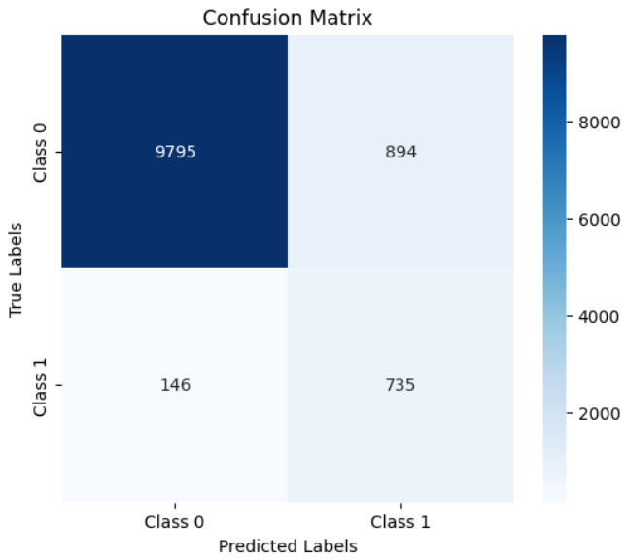

Support Vector Machine (SVM)
Simple Cross Validation
Fold 1: Training on 2021, 2022 and Testing on 2023
Accuracy: 0.910
ROC: 0.94
Grid Search Cross Validation
Fold 1: Training on 2021, 2022 and Testing on 2023
Accuracy: 0.884
ROC: 0.91
 | Precision | Recall | F1
Cotton | 0.99 | 0.92 | 0.95
Rice | 0.45 | 0.83 | 0.59
 | Precision | Recall | F1
Cotton | 0.98 | 0.89 | 0.93
Rice | 0.38 | 0.82 | 0.52
Comparing Results
The Grid Search results did not improve the results as the best parameter we provided was not good enough
C: 100
gamma: 1
kernel: rbf

Slide 12
Analysis
XGBoost: Accuracy: ~91%, F1: 0.58. Balanced, but slightly lower F1.
Bagging: Accuracy: ~93%, F1: 0.64. Best performance overall.
Random Forest: Accuracy: ~93%, F1: 0.64. Matches Bagging.
SVM: Accuracy: ~91% (~88% with GridSearch), F1: 0.59 (GridSearch: 0.52). Weakest.
Best Choice: Bagging or Random Forest for the highest F1 and accuracy. XGBoost is slightly lower in F1, while SVM lags in grid-searched performance.

Slide 13
Unsupervised Models
K-Means Clustering
Hierarchical Clustering
DB SCAN
Gaussian Mixture Models

Slide 14
Without PCA

Slide 15
Data preprocessing
Feature Scaling using MinMaxScalar.
Duplicates dropped.
Removed outliers using IQR.
Applying data augmentation using sliding window.
Combining yearly datasets.
Dropping labels.

Slide 16
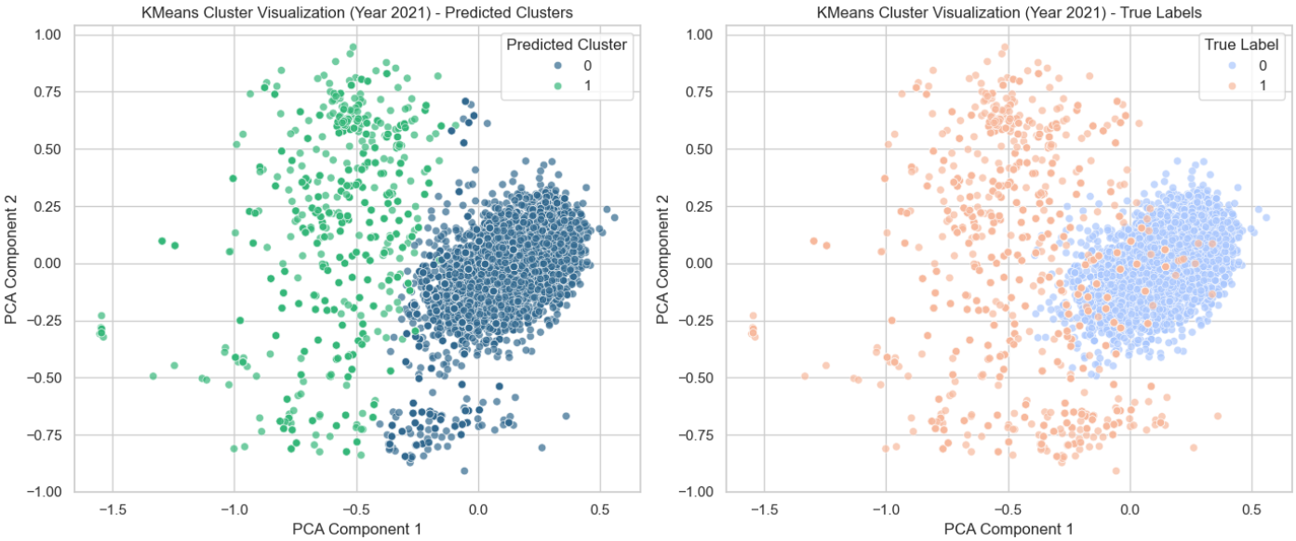
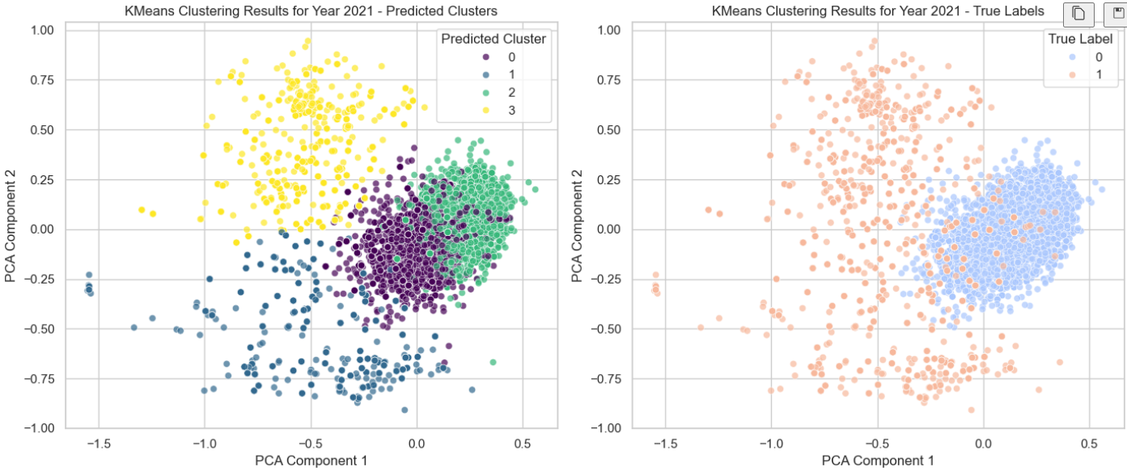
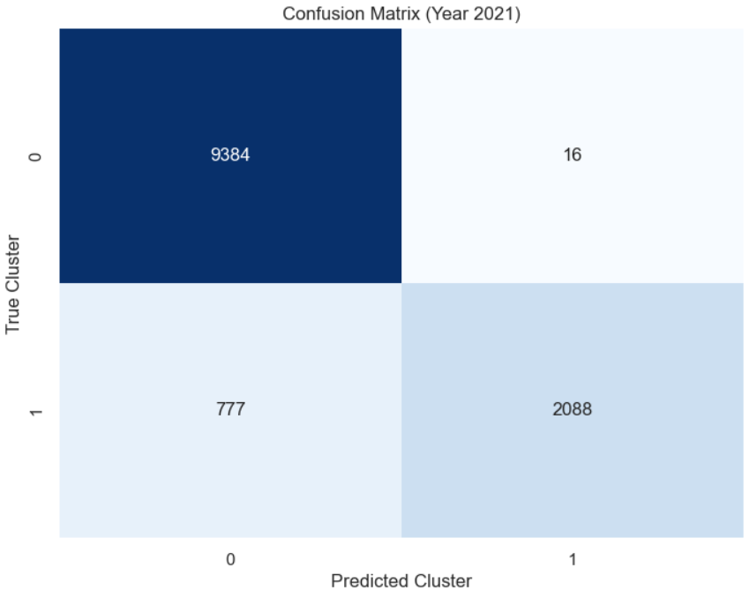
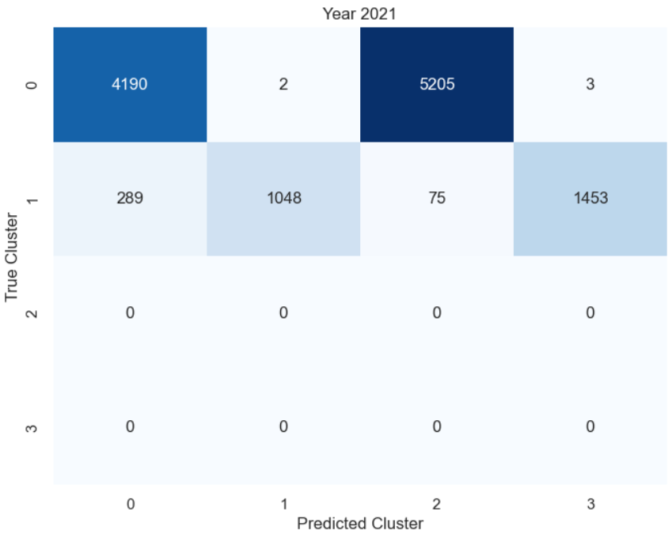
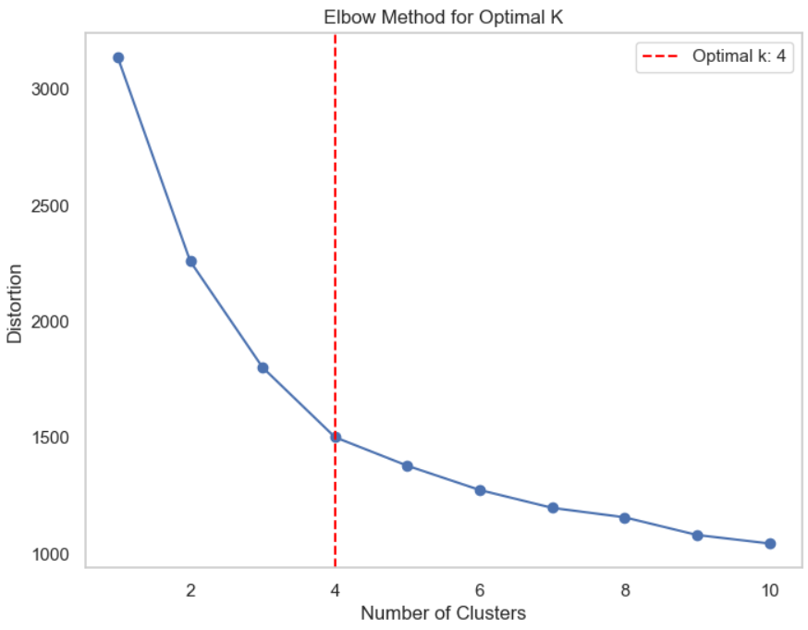
K-Means Clustering
Simple Clustering
Clustering on year 2021
Grid Search
Clustering on year 2021
Purity: 0.935 Silhouette : 0.448
Purity: 0.970 Silhouette : 0.242
Better results as we provided only 2 clusters where as in grid search it chooses 4 clusters as optimal.

Slide 17
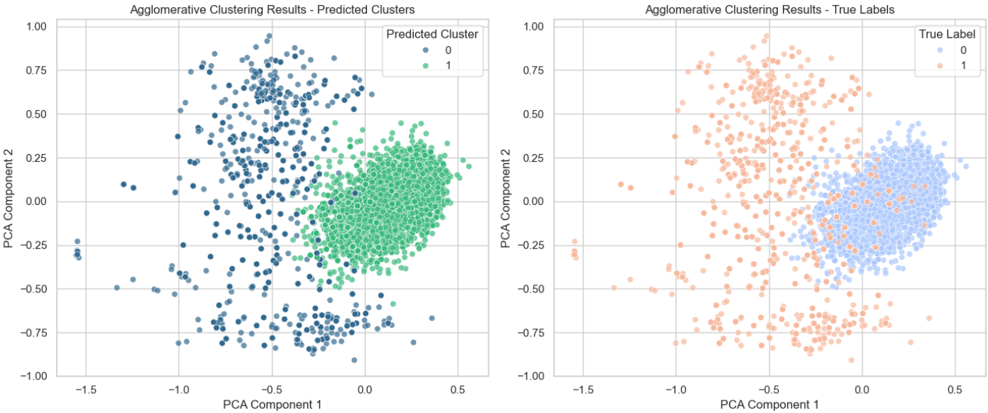
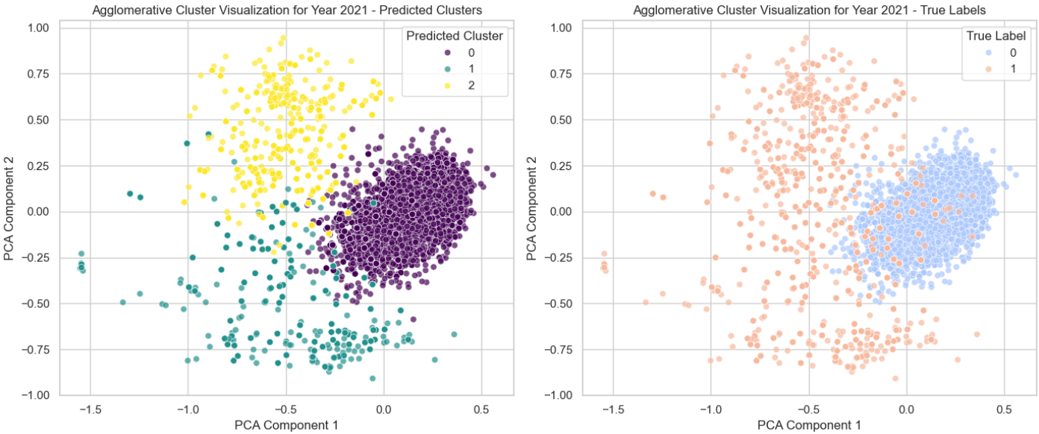
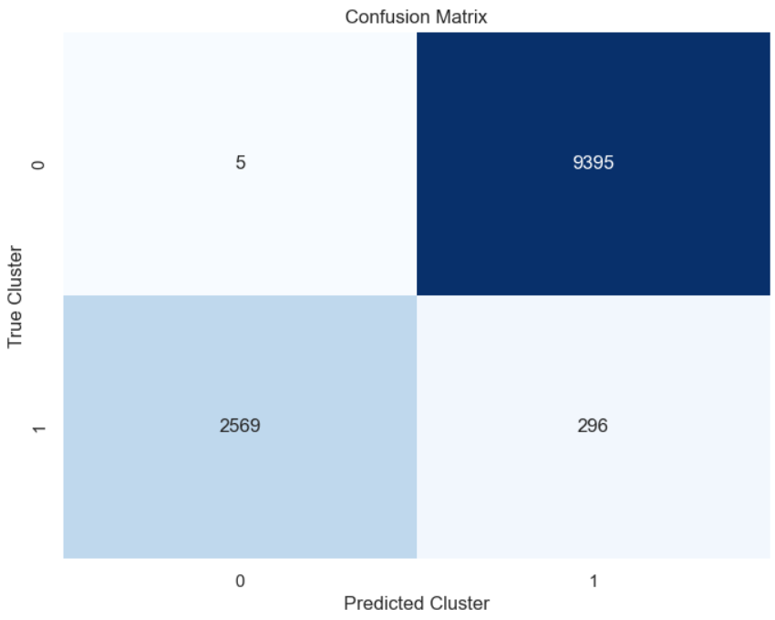
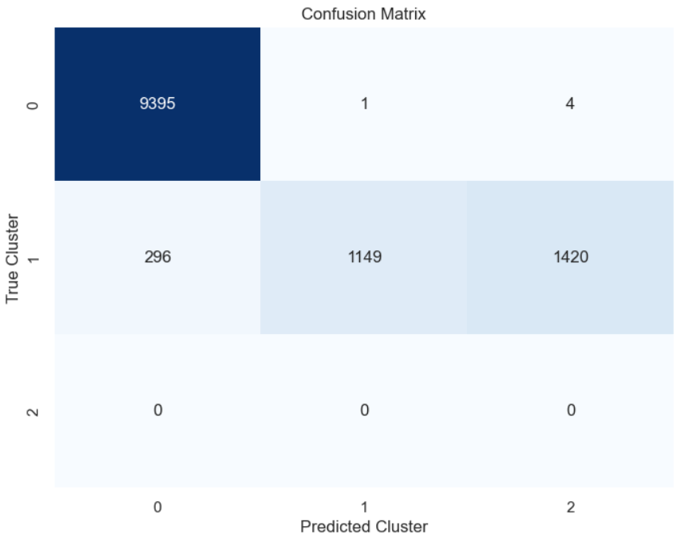
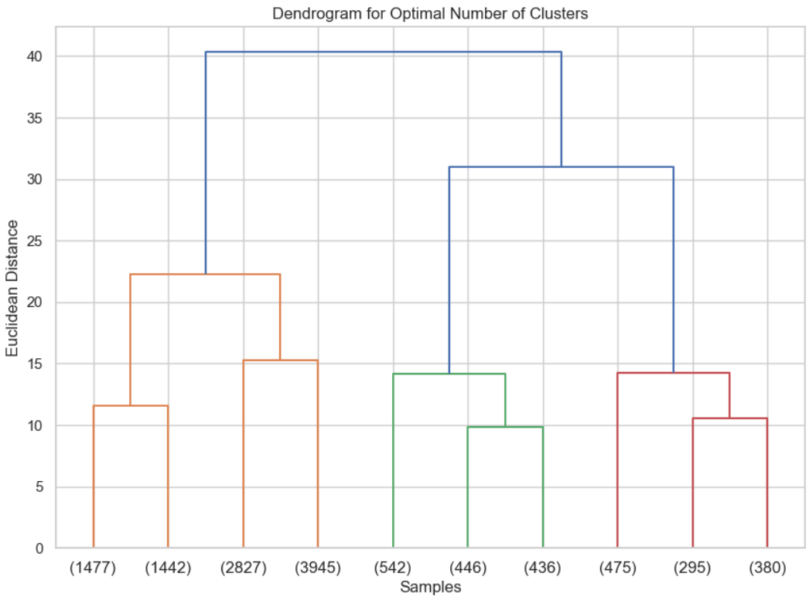
Hierarchical Clustering
Simple Clustering
Clustering on year 2021
Grid Search
Clustering on year 2021
Purity: 0.976 Silhouette : 0.438
Purity: 0.881 Silhouette : 0.458
Better results without grid search as the parameters we provided in grid search weren’t good enough.

Slide 18
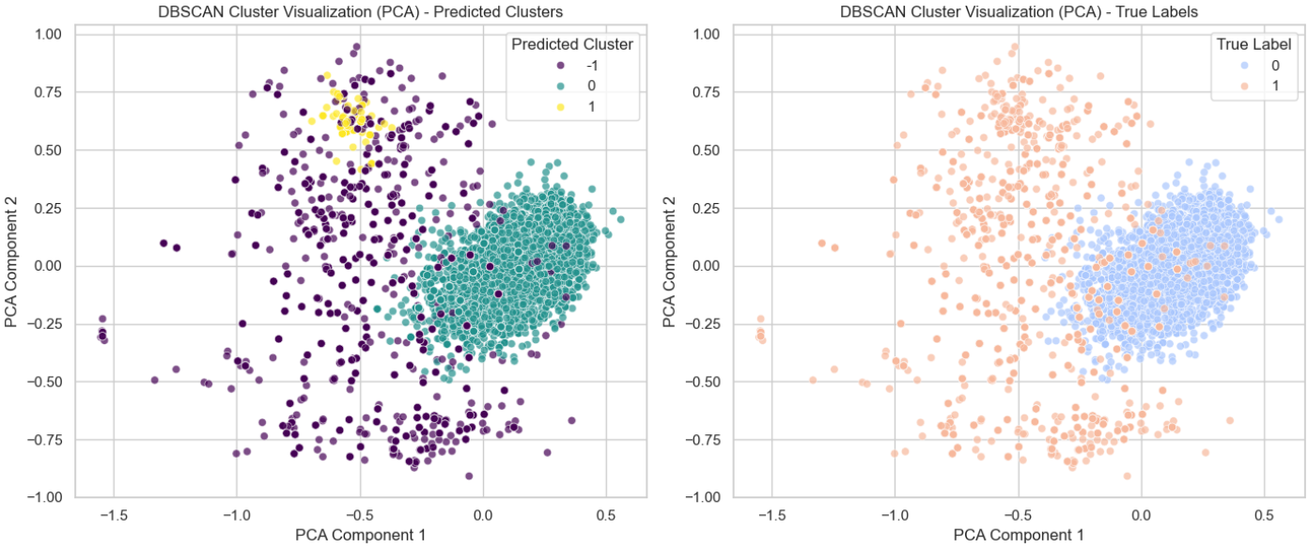
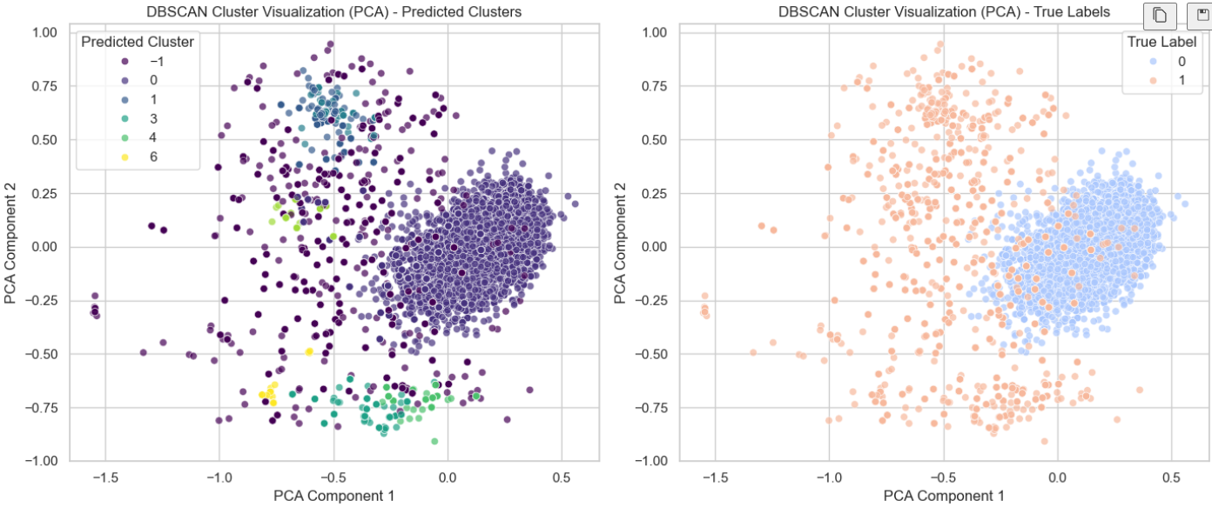
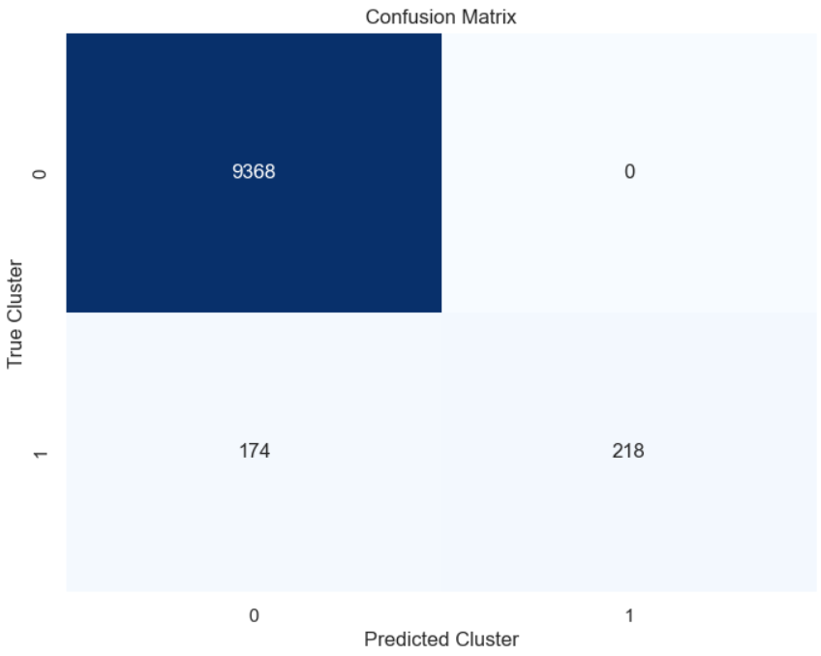
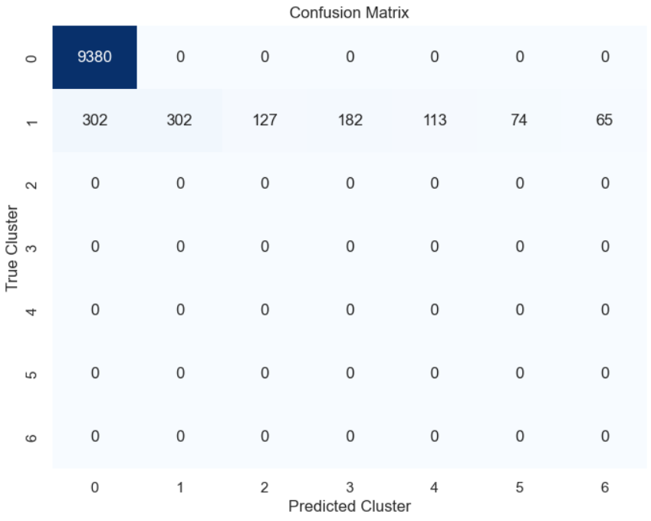
DB Scan
Simple Clustering
Clustering on year 2021
Grid Search
Clustering on year 2021
Purity: 0.982 Silhouette : 0.410
Purity: 0.971 Silhouette : 0.456
Grid Search reduced the overall purity but increased the silhouette score.
eps: np.float64(0.27) min_samples: 60

Slide 19
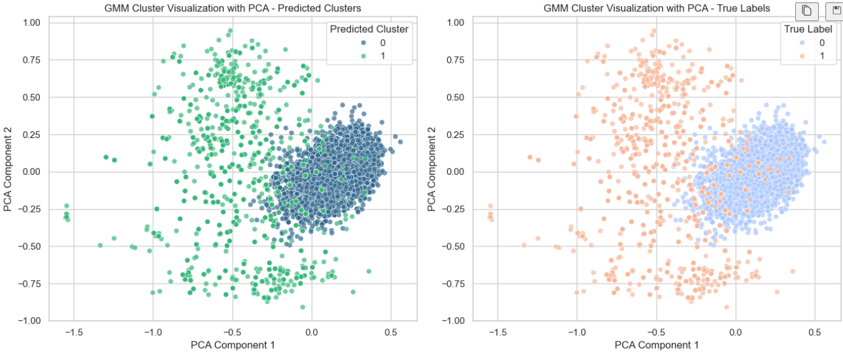
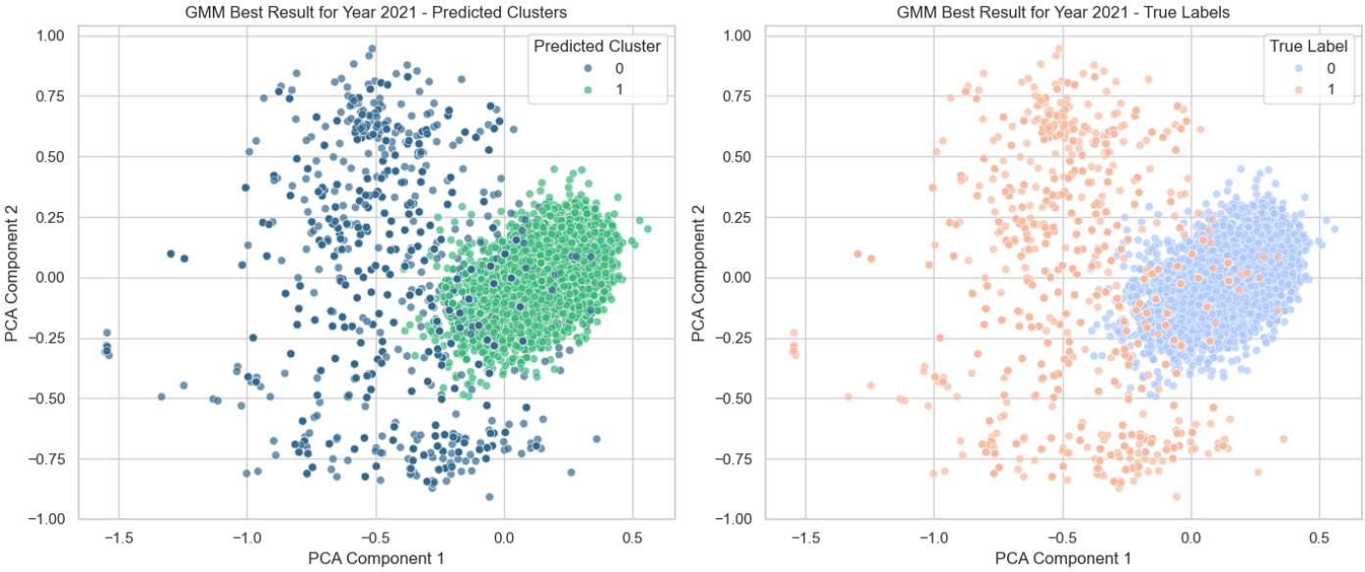
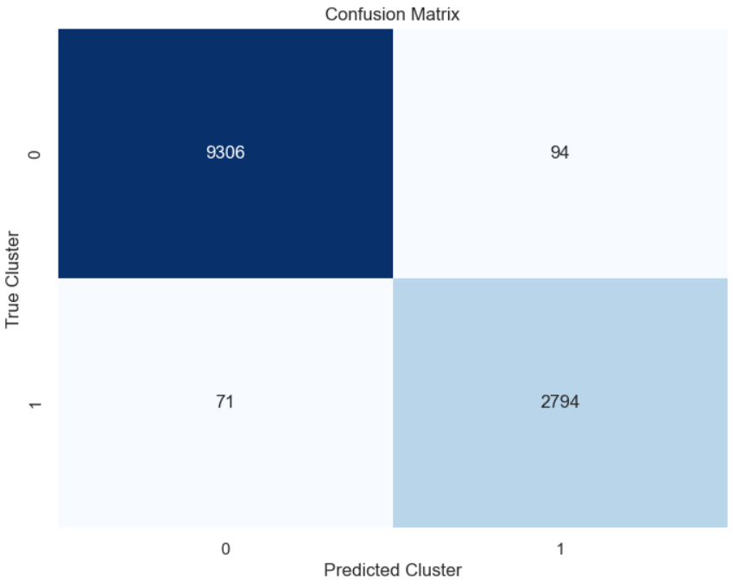
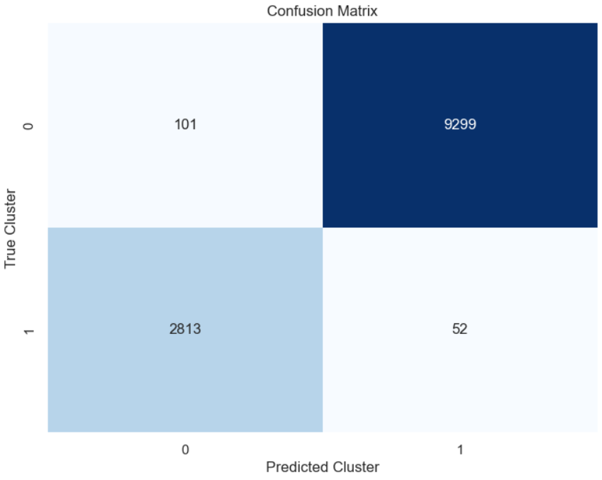
Guassian Mixture Model
Simple Clustering
Clustering on year 2021
Grid Search
Clustering on year 2021
Purity: 0.987 Silhouette : 0.408
Purity: 0.973 Silhouette : 0.406
Grid search did not improve the over all results.
covariance_type: diag init_params: kmeans n_components: 5

Slide 20
Analysis
K-Means: Best Silhouette (2021: 0.4478), High Purity (2023: 0.9668).
Hierarchical: Best Purity (2023: 0.9838), Consistent Silhouette (2021: 0.4377).
DBSCAN: Highest Purity (2023: 0.9932), Weak Silhouette (2022: 0.0907).
Gaussian Mixture: Strong Purity (2021: 0.9865), Low Silhouette (2022: 0.1678).
Hierarchical is the best due to its balance between clustering quality (silhouette) and accuracy (purity). DBSCAN is preferable only when the highest purity is essential, despite occasional structural weaknesses.

Slide 21
With PCA

Slide 22
Data preprocessing
Feature Scaling using MinMaxScalar.
Duplicates dropped.
Removed outliers using IQR.
Applying data augmentation using sliding window.
Combining yearly datasets.
Applying PCA kept 5 principal components
Dropping labels.

Slide 23
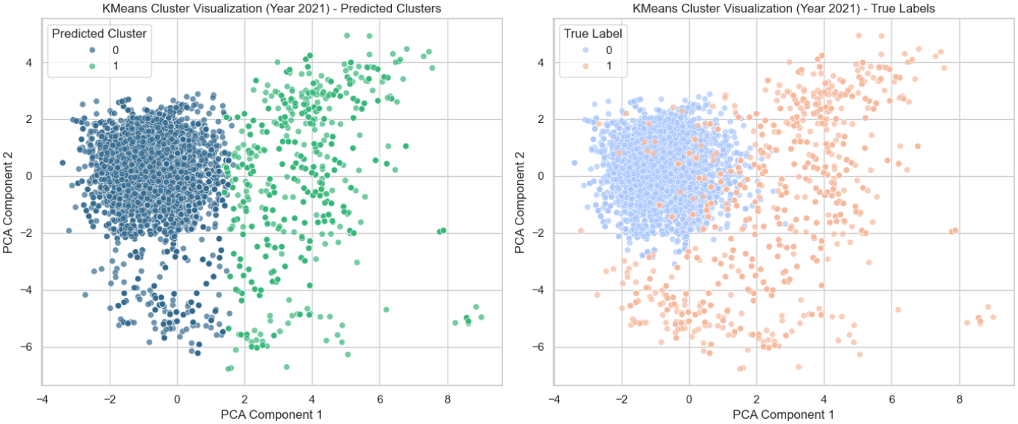
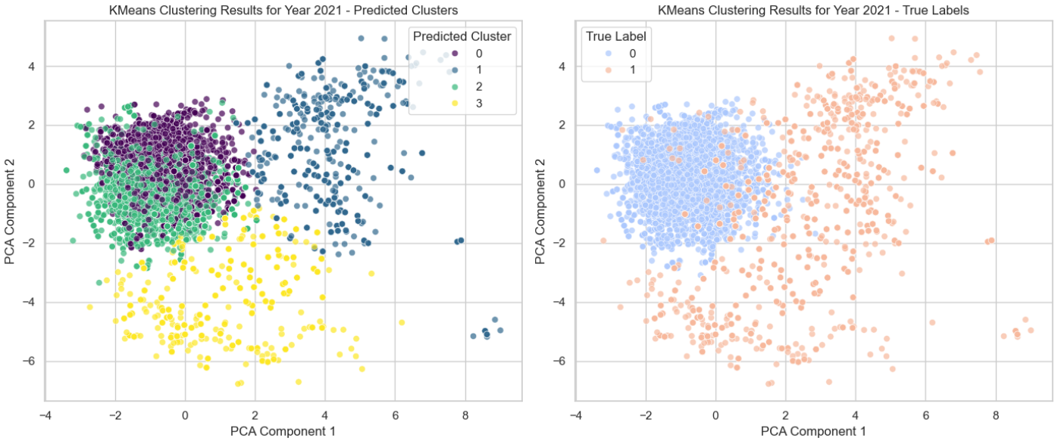

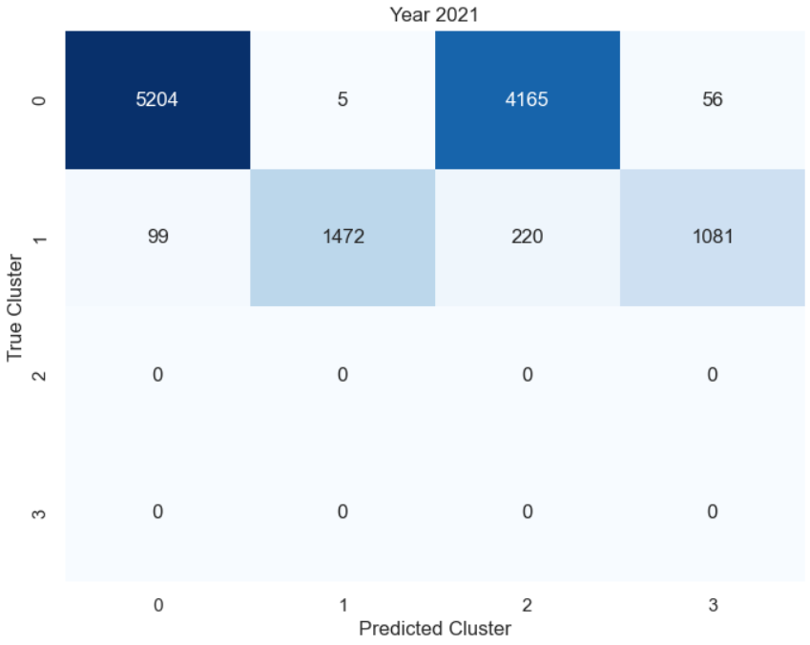
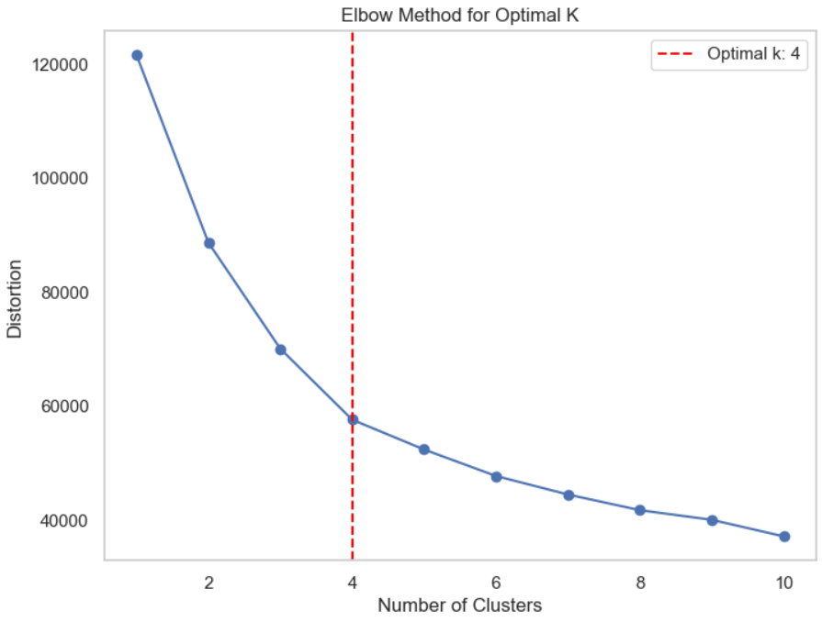
K-Means Clustering
Simple Clustering
Clustering on year 2021
Grid Search
Clustering on year 2021
Purity: 0.932 Silhouette : 0.435
Purity: 0.969 Silhouette : 0.248
Better results as we provided only 2 clusters where as in grid search it chooses 4 clusters as optimal.

Slide 24
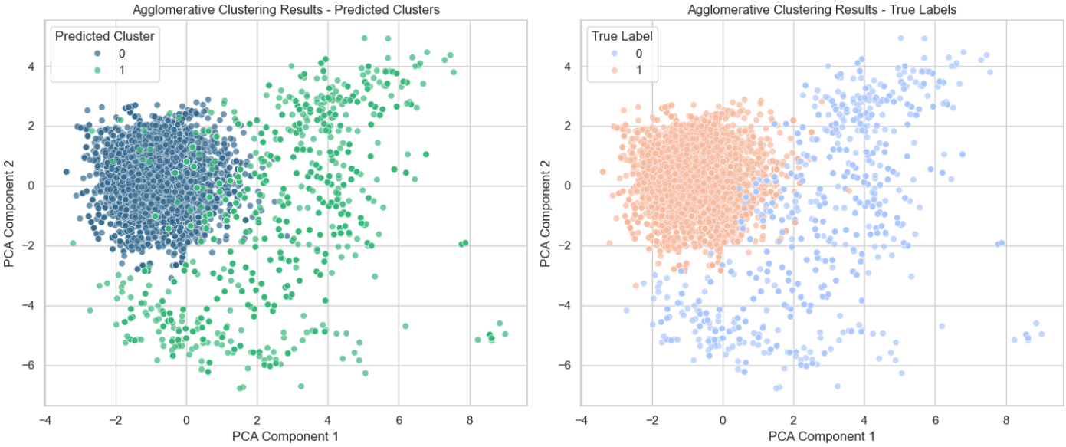
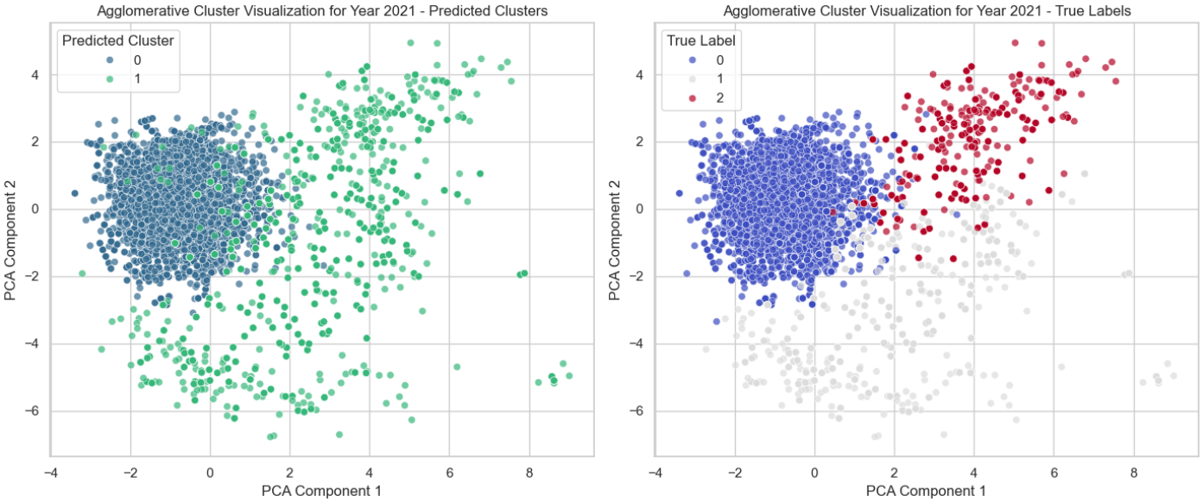

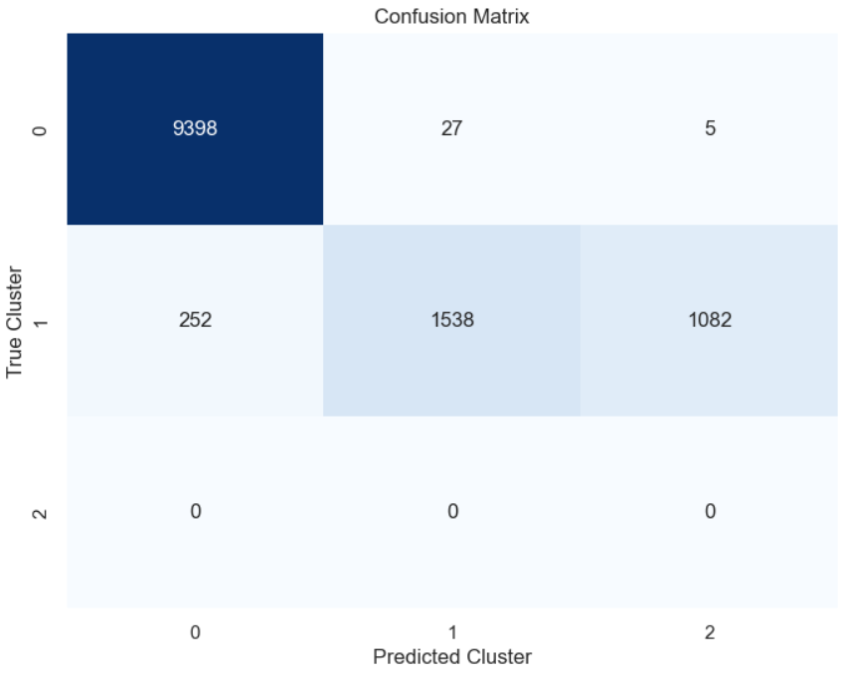
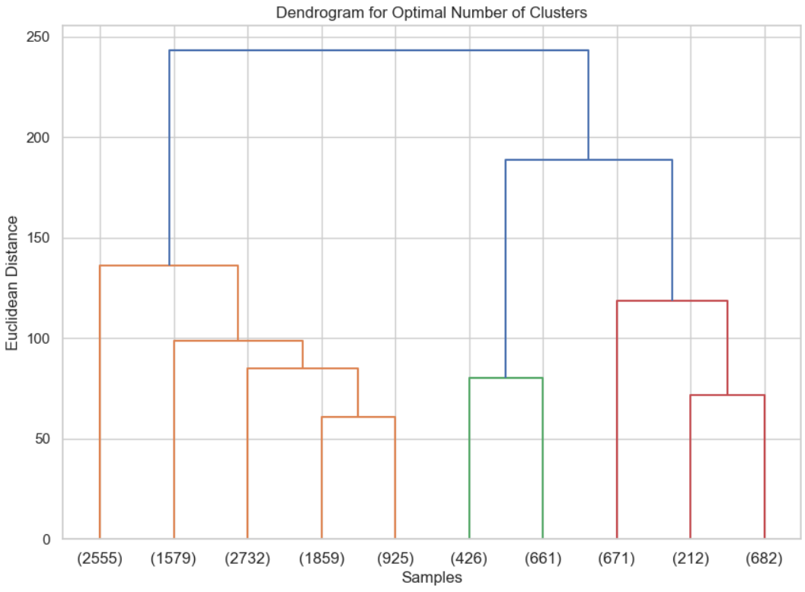
Hierarchical Clustering
Simple Clustering
Clustering on year 2021
Grid Search
Clustering on year 2021
Purity: 0.977 Silhouette : 0.417
Purity: 0.977 Silhouette : 0.431
Better results in grid search as purity and silhouette score is increasing.

Slide 25
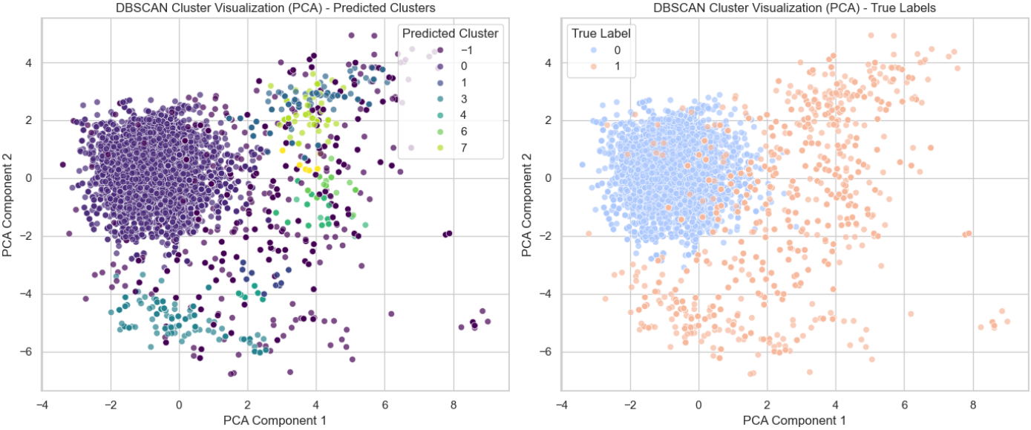
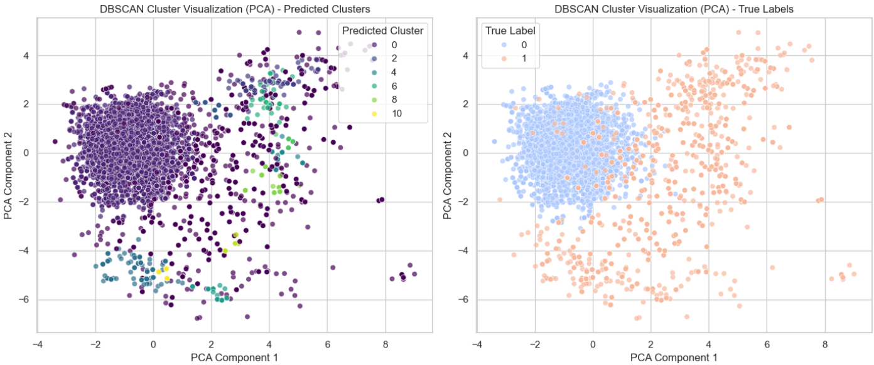
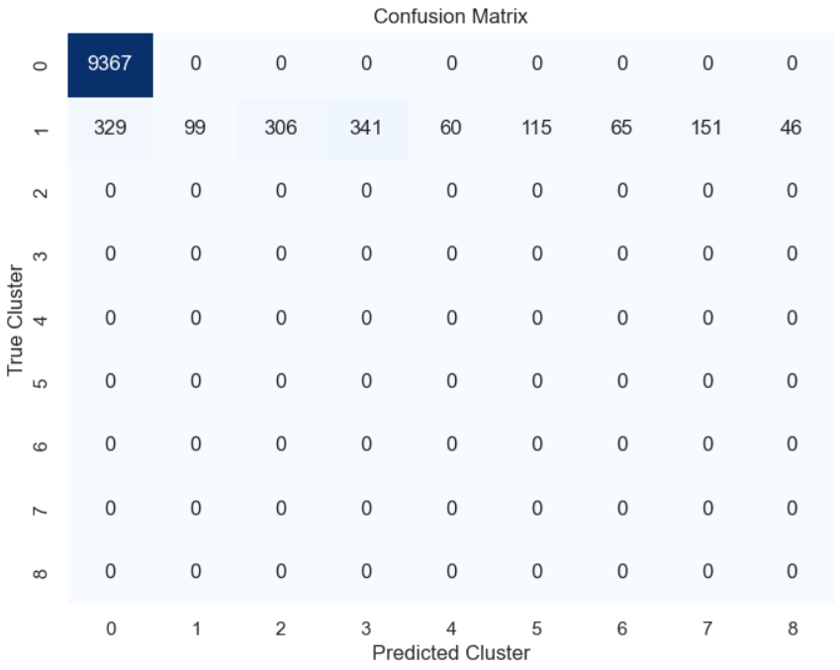
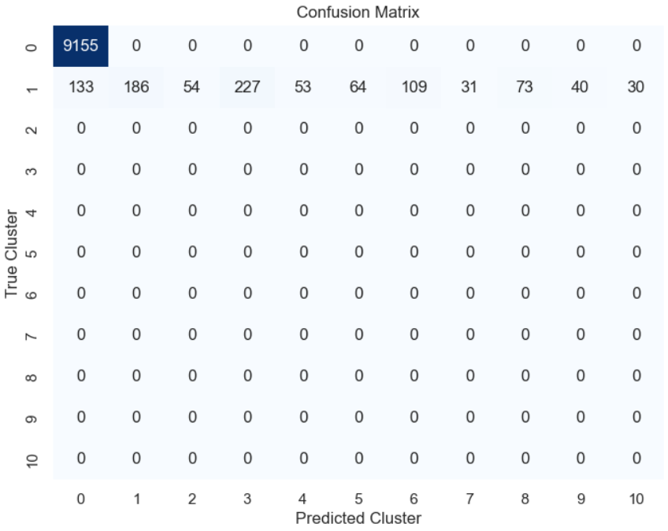
DB Scan
Simple Clustering
Clustering on year 2021
Grid Search
Clustering on year 2021
Purity: 0.970 Silhouette : 0.302
Purity: 0.987 Silhouette : 0.241
Grid Search increased the overall purity but decreased the silhouette score.
eps: np.float64(1.0) min_samples: 31

Slide 26
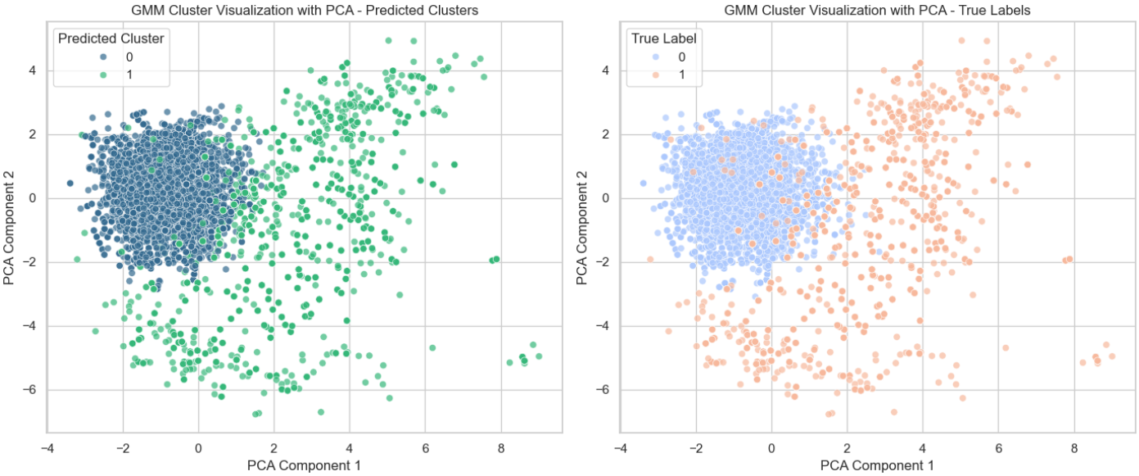
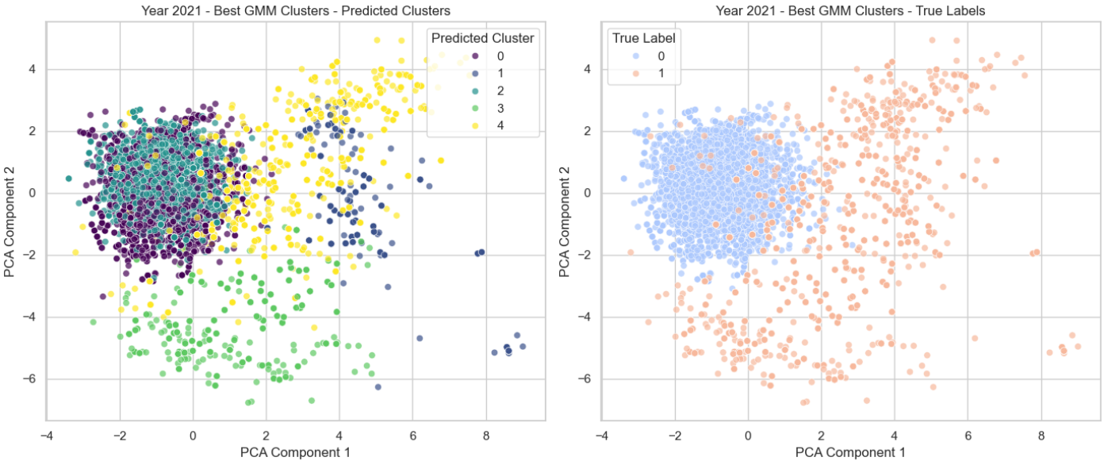
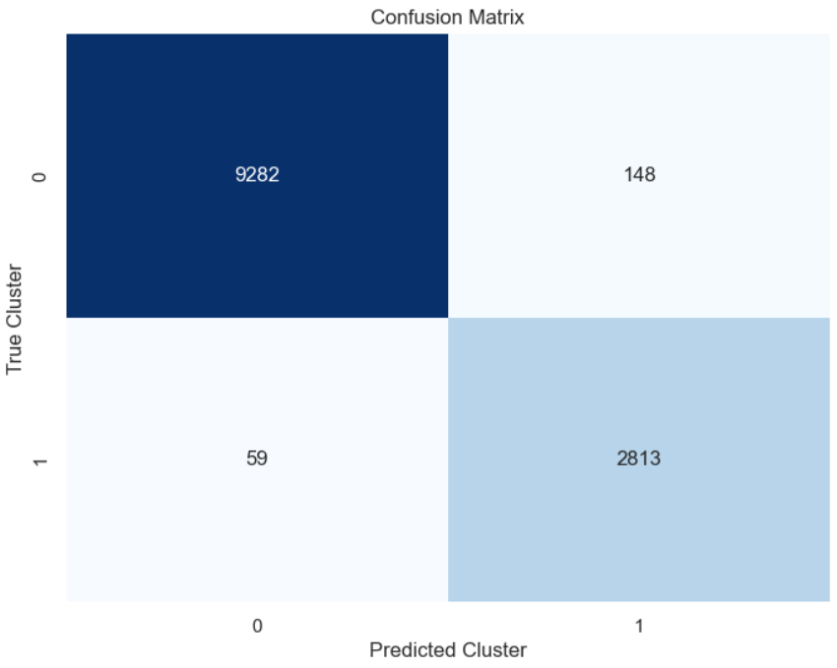
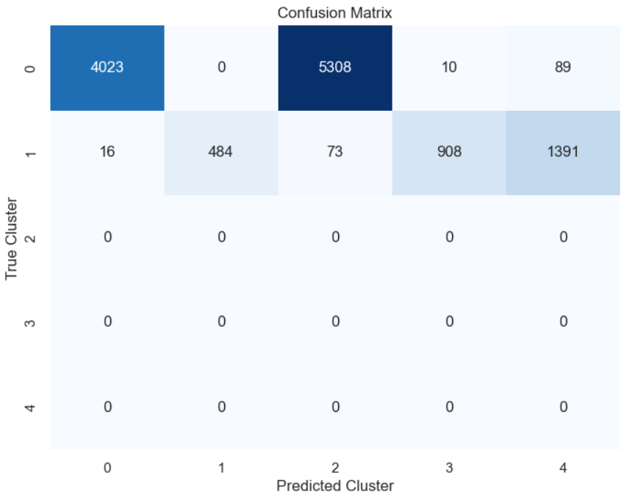
Guassian Mixture Model
Simple Clustering
Clustering on year 2021
Grid Search
Clustering on year 2021
Purity: 0.983 Silhouette : 0.397
Purity: 0.985 Silhouette : 0.147
Grid search improved the purity but significantly decreased the silhouette score.

Slide 27
Analysis
K-Means: High purity (2023: 0.9710), decent Silhouette (2023: 0.4482).
Grid Search: Good purity (2023: 0.9637), lower Silhouette (2022: 0.2774).
Hierarchical: Balanced, high purity (2023: 0.9808) and solid Silhouette (2023: 0.4415).
DBSCAN: Highest purity (2023: 0.9896), weak Silhouette (2023: 0.2425).
Best Model: Hierarchical Clustering stands out as the best, offering a strong balance between Silhouette score (2023: 0.4415) and purity (2023: 0.9808), ensuring both good cluster quality and accuracy.

Slide 28
With PCA and Without PCA
With PCA performs better than without PCA.
Improved Purity: K-Means and DBSCAN show higher purity scores with PCA (K-Means: 0.9710, DBSCAN: 0.9896) compared to without PCA.
Stable Clustering: Hierarchical maintains balanced performance with both high purity and solid Silhouette scores (with PCA: 0.4415, without PCA: 0.4377).
Better Overall Performance: With PCA, models like K-Means and DBSCAN perform better in terms of purity, while Hierarchical remains the most reliable model overall.

Slide 29
Question Answer

